Slide 1
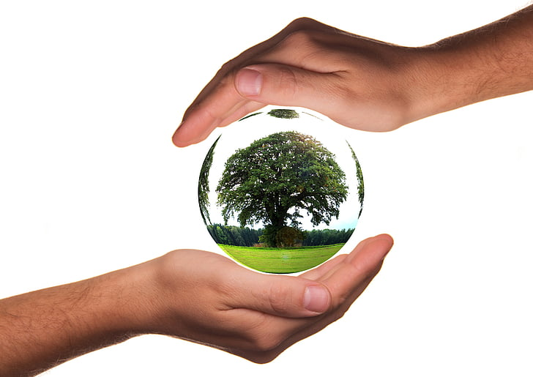
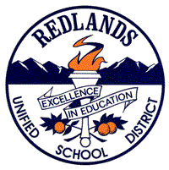


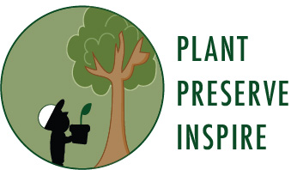
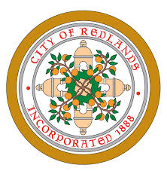

Earth Day 2020: Trees, Please!

Slide 2
Redlands Unified School District (RUSD) is the school District that your school is in!
University of Redlands is a private institution of higher education here in Redlands
Environmental Systems Research Institute (ESRI)
Creator of Geographic Information Systems (GIS), software that collects and analyzes data in a geographical context
“The Science of Where”
The City of Redlands is where you attend school. City staffers work hard to make Redlands a wonderful place to live, work and study!
Inland Empire Resource Conservation District (IERCD)
a local government agency that provides a range of services in habitat conservation, and education to residents in the Inland Empire.

Slide 3
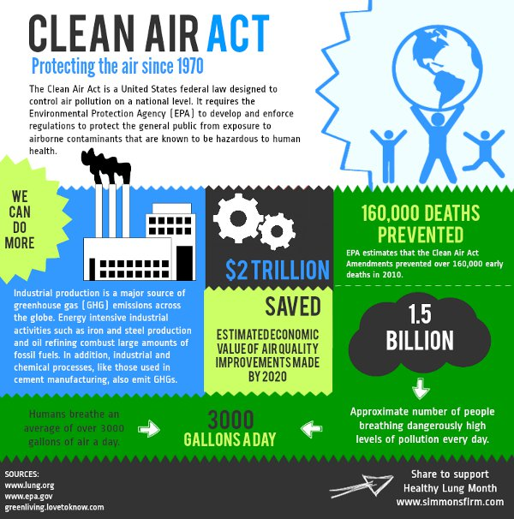
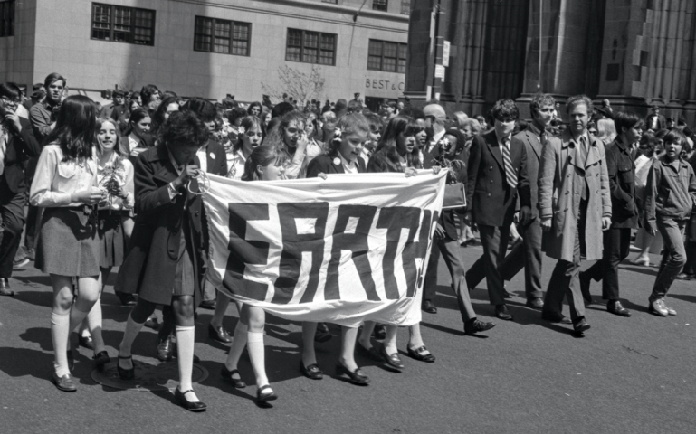
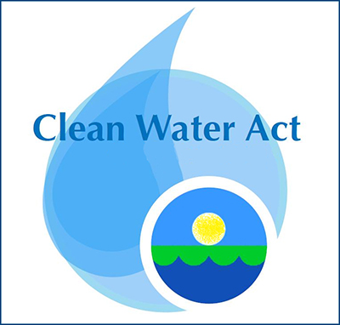
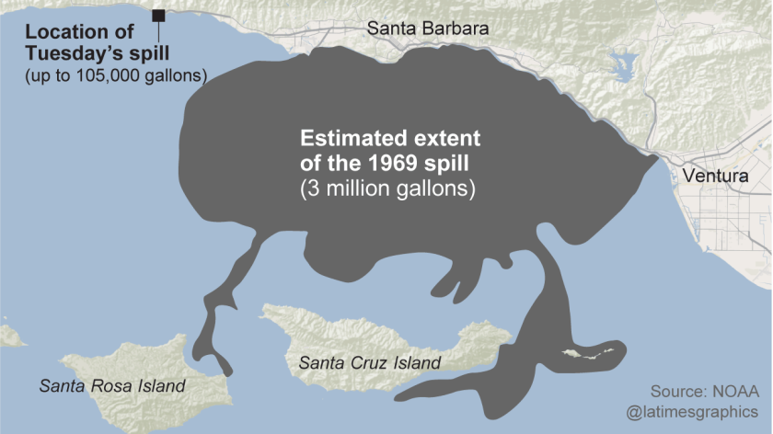

Origins of the first Earth Day: April 22nd, 1970
Target Participants: students
Event: January 28th, 1969 Santa Barbara oil spill
Resulting Impact: landmark legislation
Notes:
Origins: 1969 Santa Barbara oil spill - 3 M gallons reaching Channel Islands, adding to other significant conservation issues at the time - loss of wilderness, wildlife extinctions, proliferation of freeways, unchecked toxic waste
Target participants: Students; Earth Day was deliberately scheduled to occur prior to typical University finals - hoping students would participate on a large scale. Ultimately, 10% of US population (20 M in 1970) celebrated via protesting a range of alarming trends impacting environmental and public health
Results - ground-breaking legislation, designed to address major conservation needs - Endangered Species Act (1973), Clean Water Act (1972), Clean Air Act (1970)

Slide 4
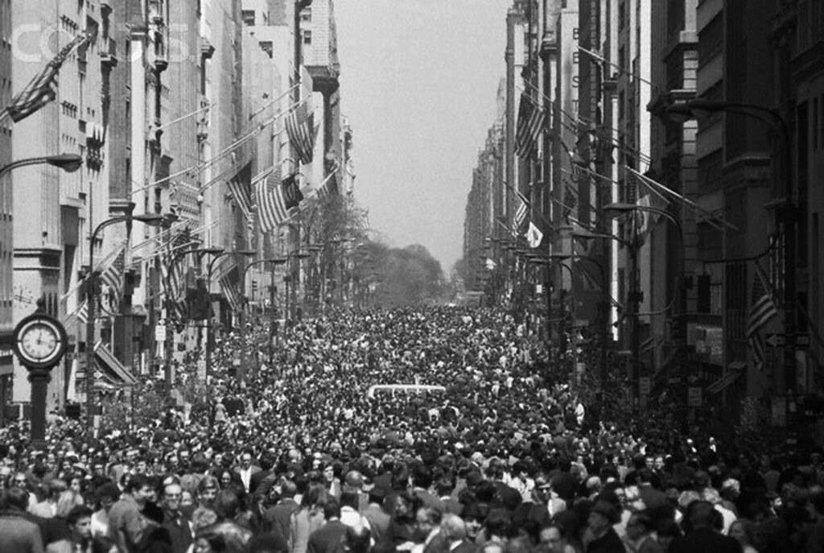
Lasting impact of the first Earth Day: first large-scale organized movement in recognition of the connection between environmental health and human health

Slide 5
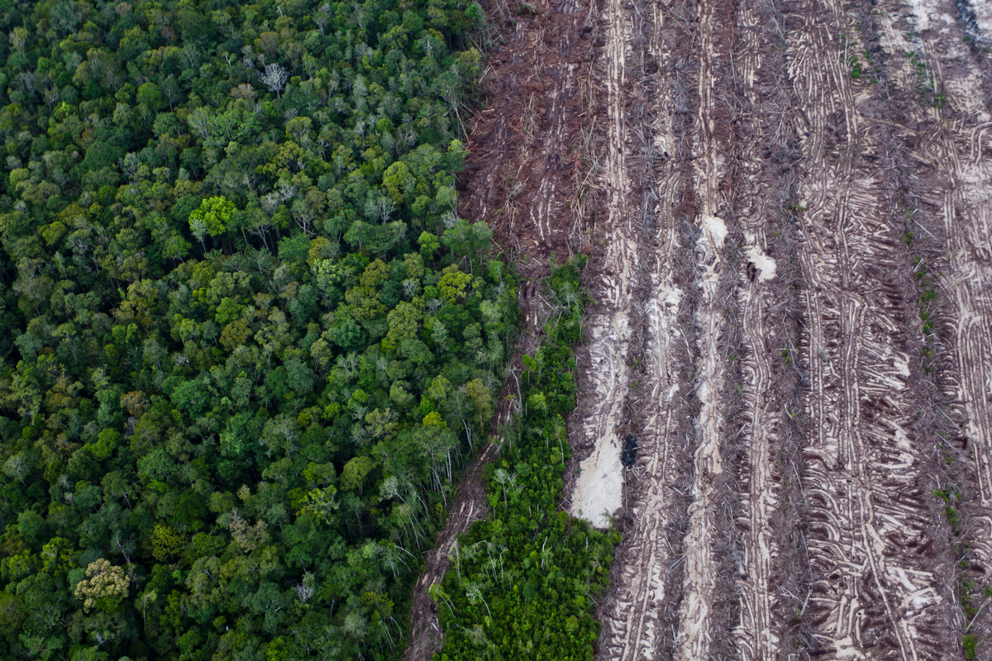
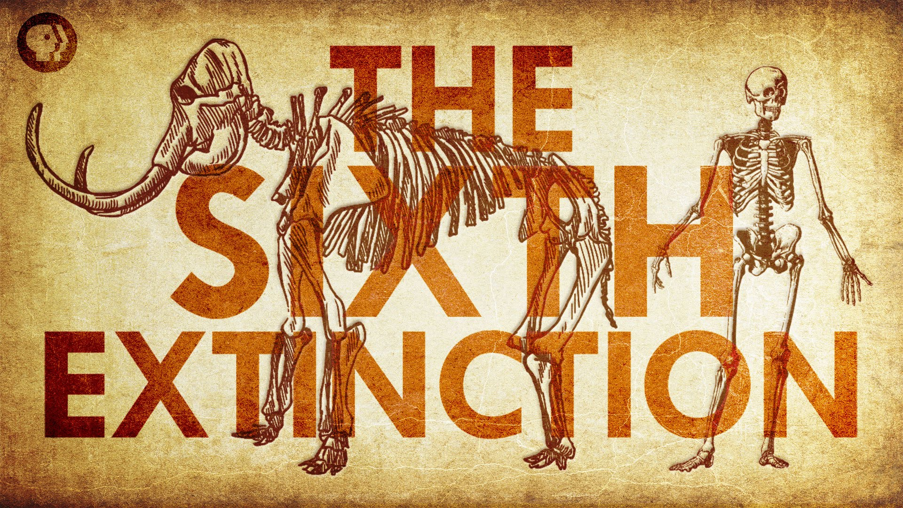

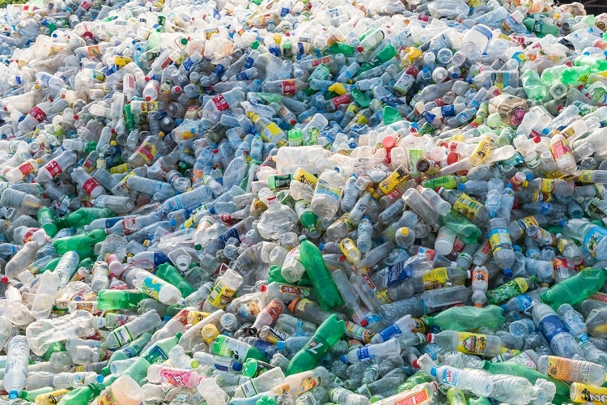
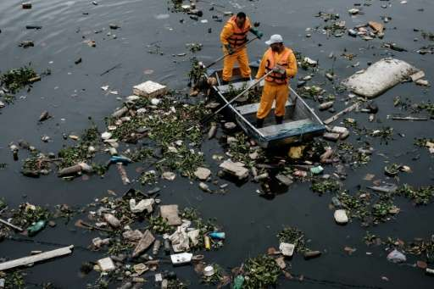
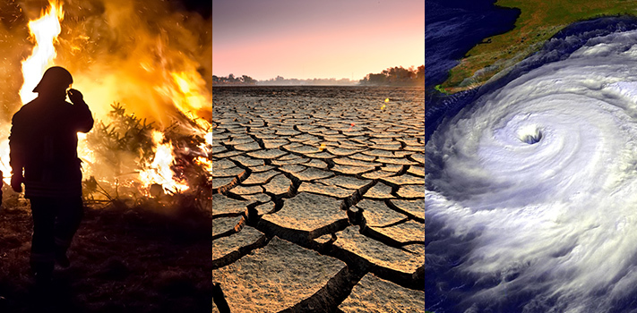
April 22nd, 2020
Why continue to celebrate Earth Day?
Notes:
Why: significant environmental concerns remain 50 years after the first Earth Day (solicit student input prior to populating pictures): global warming (temps increasing), climate change (temps increasing plus associated impacts - melting glaciers, escalating fire season, extreme drought); mass extinction event; water pollution; single-use plastic impacts; deforestation - could go on and on
Why: power of youth; Harvard’s Institute of politics shows the following support for environmental action:
80 percent support from 18-39 year olds
71 percent from 40-64 year olds
55 percent from those 65 and older
25% gap in belief in action as people age - power to effect meaningful change remains with our youngest demographic

Slide 6
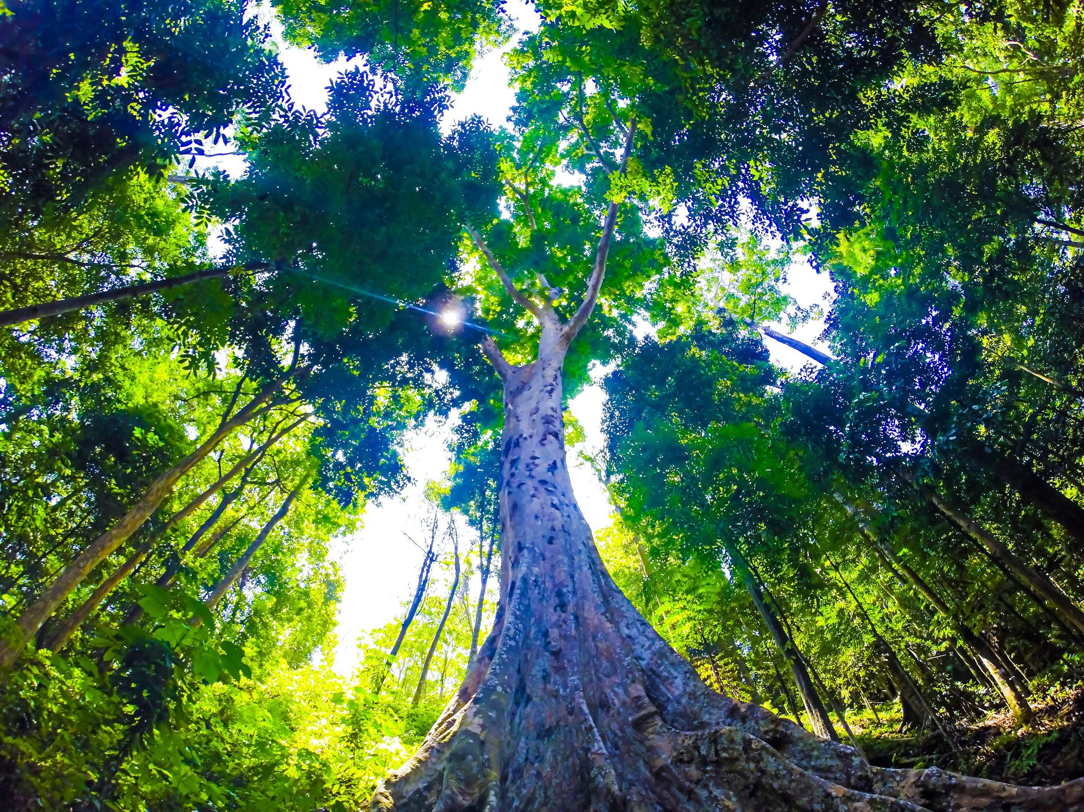
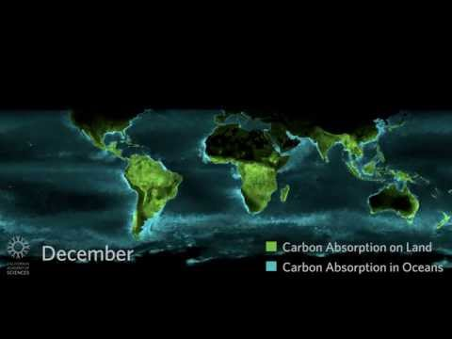

HS-LS2-5: Develop a model to illustrate the role of photosynthesis and cellular respiration in the cycling of carbon among the biosphere, atmosphere, hydrosphere, and geosphere.

Slide 7
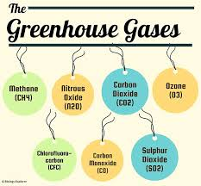
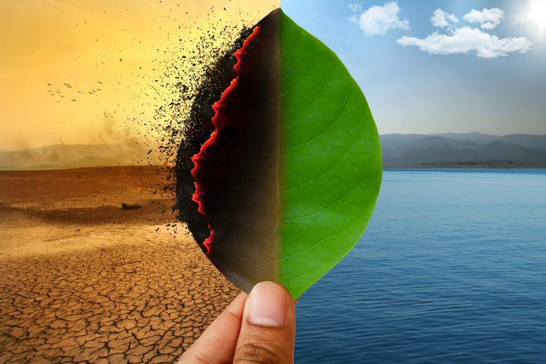
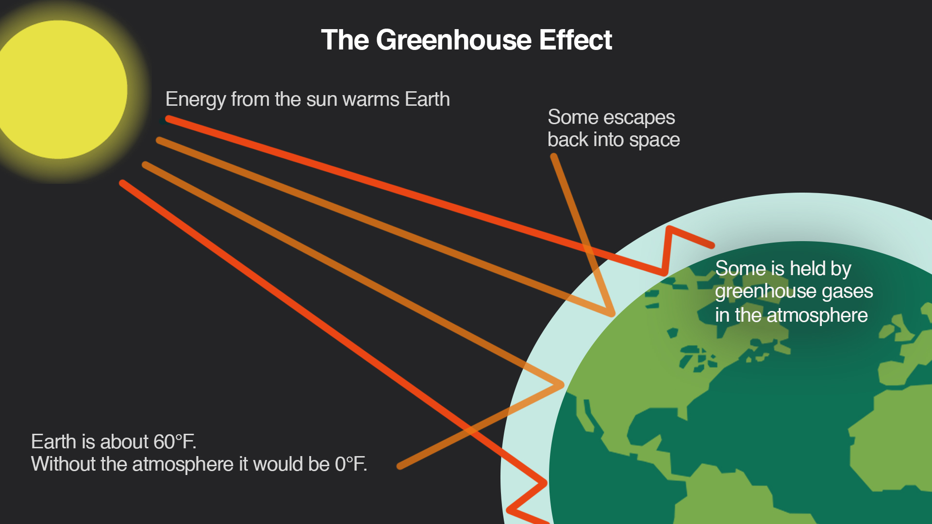
Spotlight on Climate Change
Human activities such as fossil fuel burning and land-use change life deforestation lead to increases in greenhouse gases which causes an increase in the amount of trapped heat..
Climate impacts of rising temperatures: fire, extreme drought, oceans rising, warming, acidifying
Notes:
The Greenhouse Effect: warming due to gases in the earth’s atmosphere allowing light to escape while retaining heat -like a greenhouse; essential for life, given that the earth without the greenhouse effect would be zero degrees F, unlivable for life
For thousands of years, GHG emitted have been balanced by GHG absorbed, making the earth livable within a consistent temperature range
In the last 150 years, average global temps have risen faster than any other measured period of time in recorded history; connected to increased GHG from human activities, resulting in higher average temperatures which in turn cause impacts including glacial retreat, increasingly catastrophic fire with kill rates of 95%+; extreme flooding events; volatility in species interactions

Slide 8
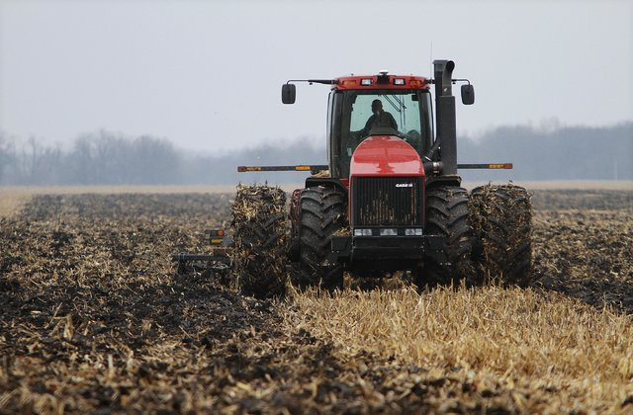
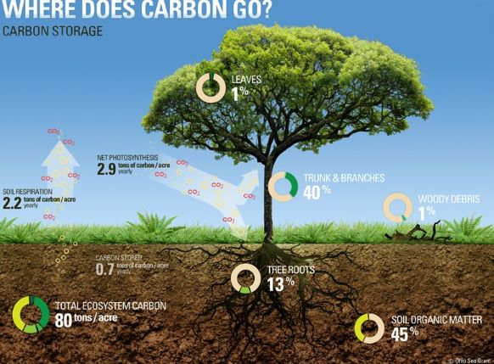
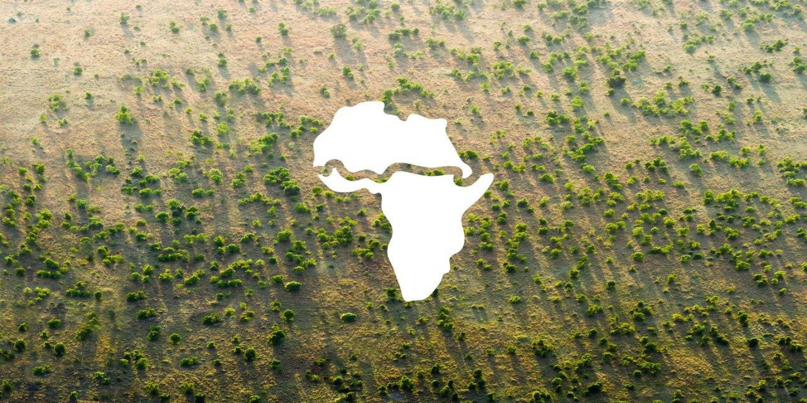
Climate change strategy 1: reduce activities contributing to GHG
Climate change strategy 2: create carbon sinks!
The Great Green Wall in Africa will result in 8,000 km of trees across the continent by 2030
One healthy hardwood tree sequesters on average 1 ton of CO2 over its lifetime - about three months of regular use of a passenger vehicle
Notes:
Addressing climate change: To adequately address climate change, the most important change to be made is reducing release of GHG Into the atmosphere - without question. Human activities/behavior that are increasing presence of GHG in the atmosphere must change, via (1) changing large-scale land management from techniques that release carbon (tilling) to those that sequester carbon (no-till and cover crops) and (2) reducing fossil fuel combustion by using green sources for energy and transportation
Strategy 2: Take action by creating carbon sinks!
In Africa, 20 countries are partnering in developing the Great Green Wall, 8000km of trees across the continent and will impact 15 of 17 components of sustainability including restoring 100 hectares of degraded land; sequestering 250 tonnes of carbon, and creating 10 million jobs in rural areas
Why do this? Trees are carbon sinks, meaning they uptake GHG CO2 during photosynthesis as they grow, then retain it in their leaves, trunks, branches, and roots. On a large scale, the planet has 3.5M square miles (about the size of the US) of areas identified as suitable for replanting with approximately 1 trillion trees which would reduce current GHG levels by 25%, reducing them to where they were 60 years ago! While one tree doesn’t represent a hugely significant carbon sink, urban and rural forests absolutely impact GHG levels in the fight against climate change

Slide 9
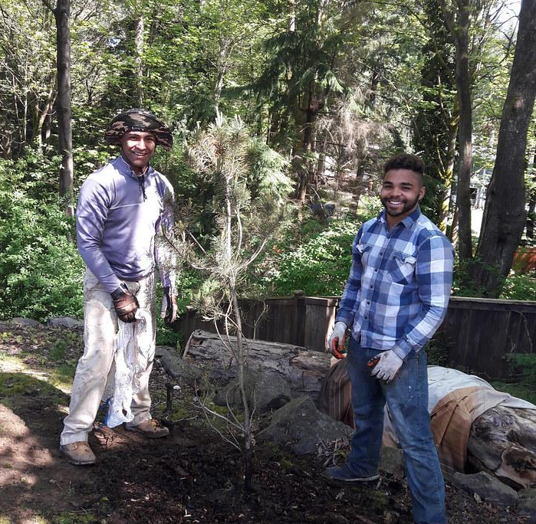
Climate action for Earth Day 2020: Trees for every RUSD student!

Slide 10
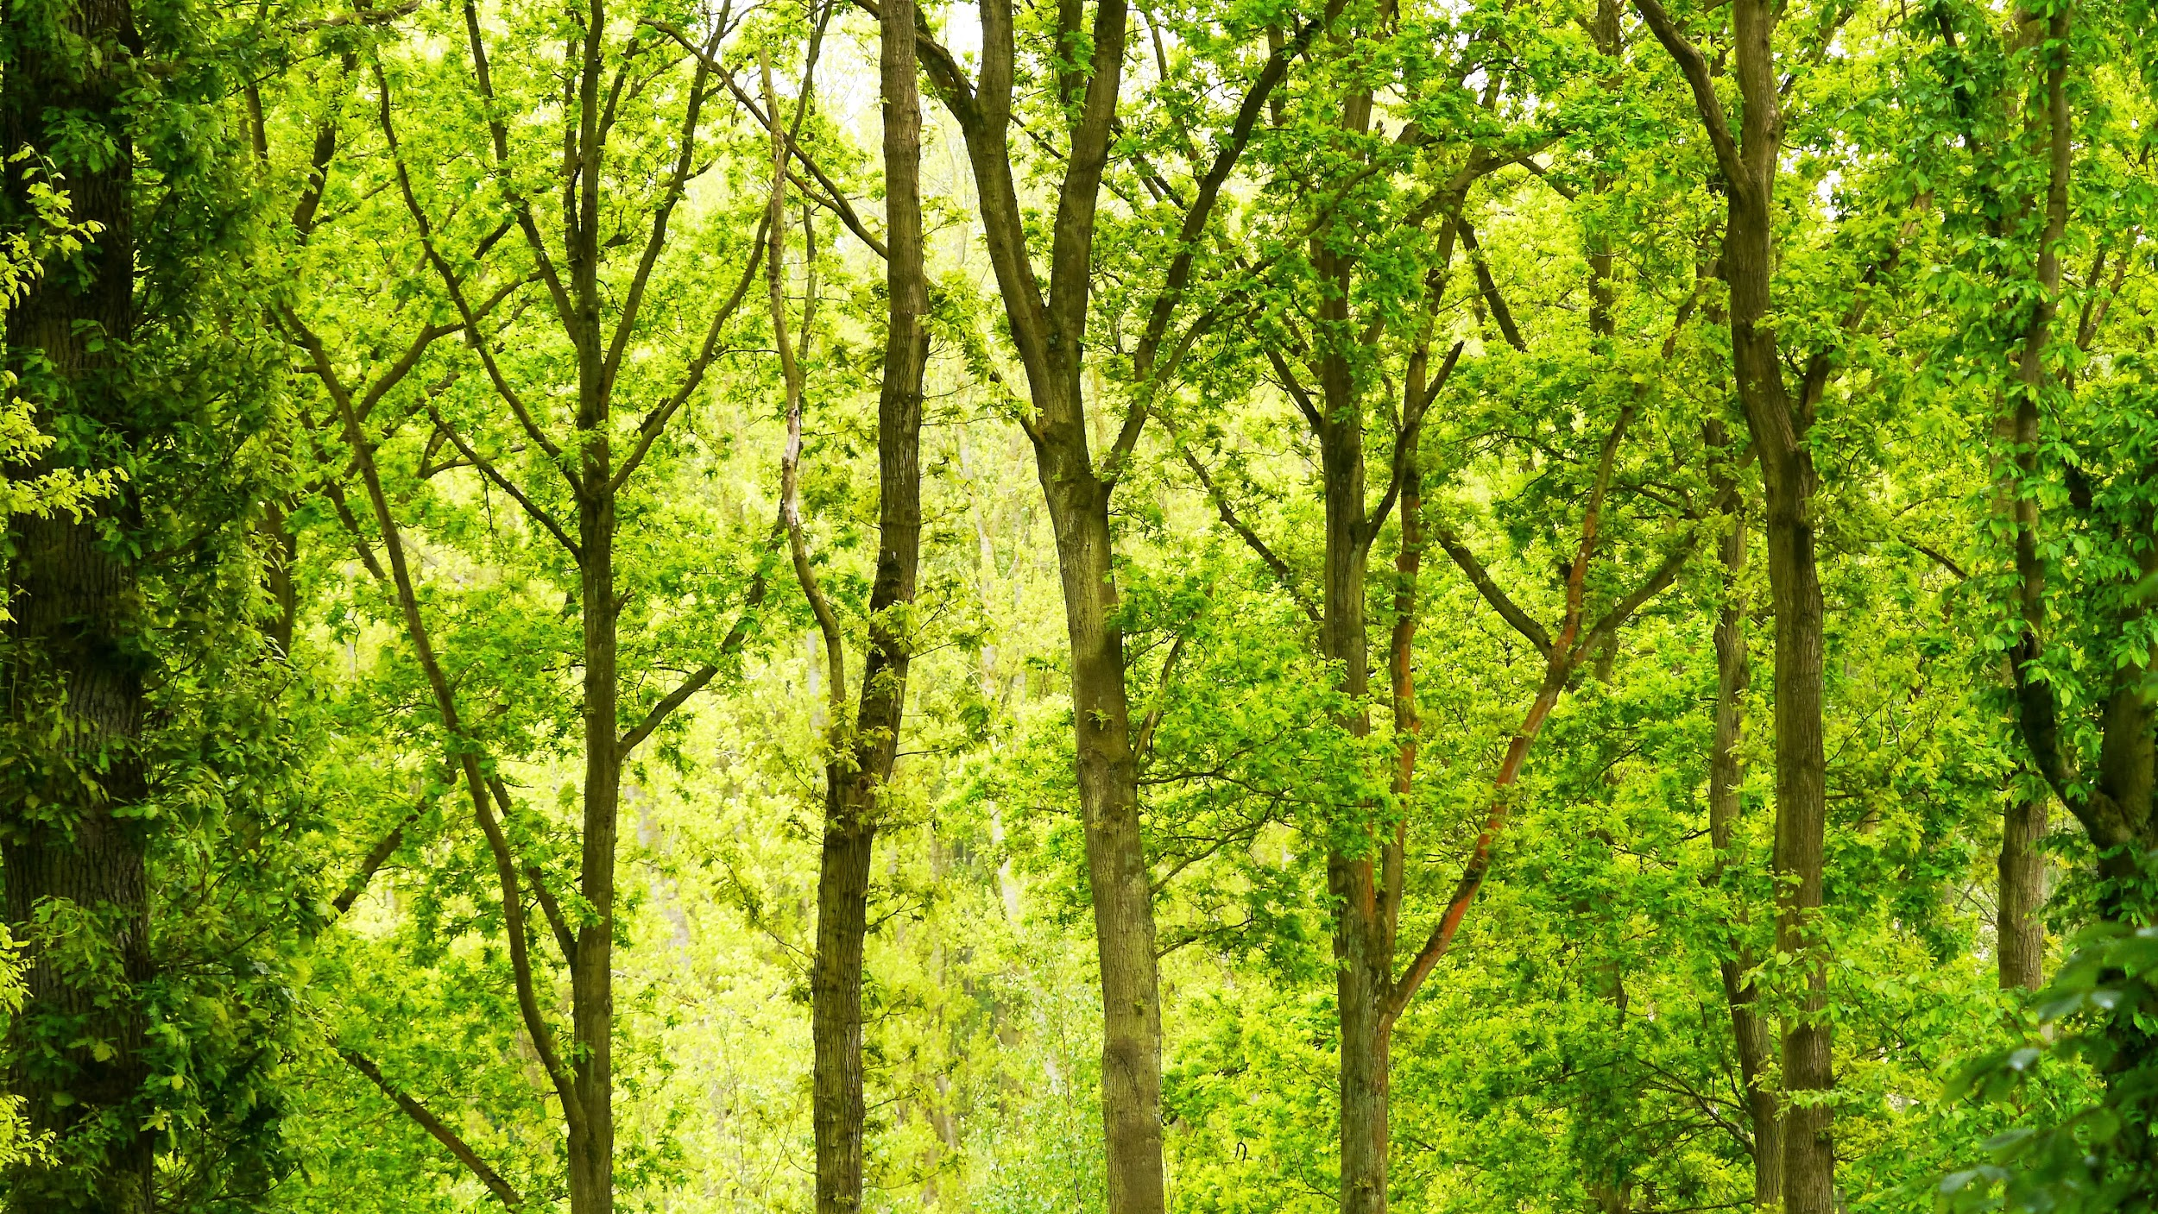
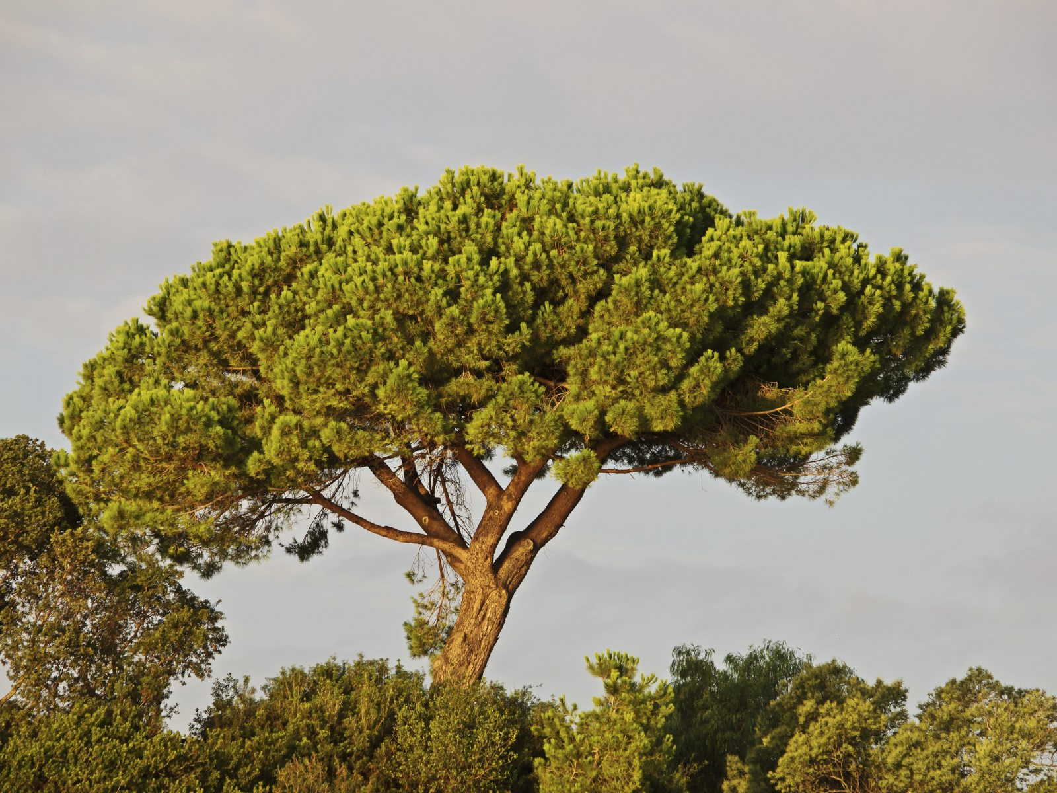
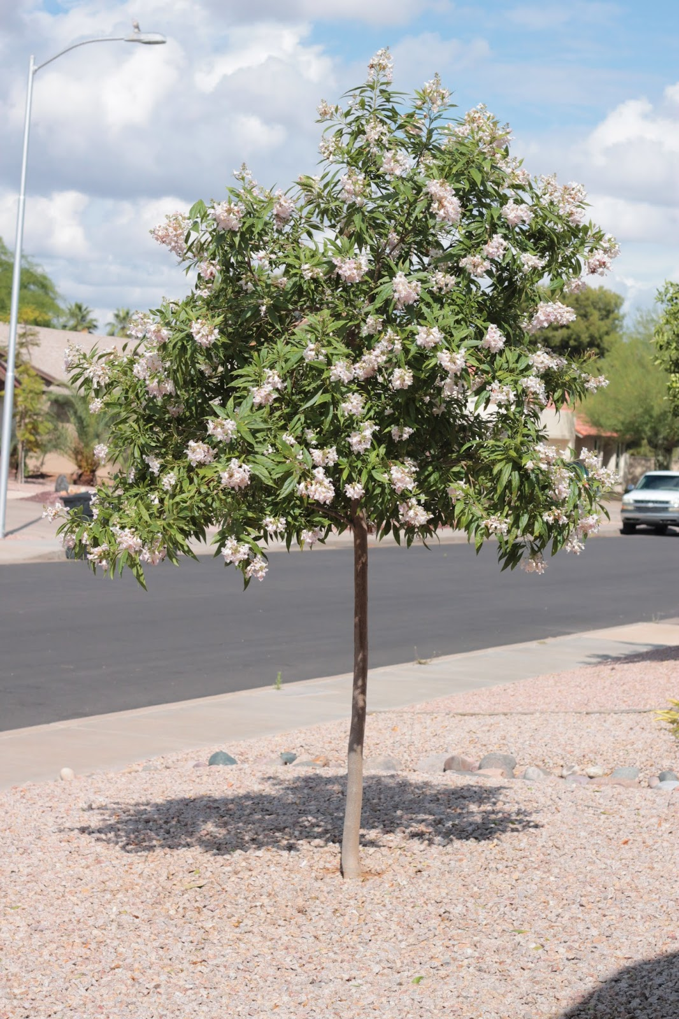
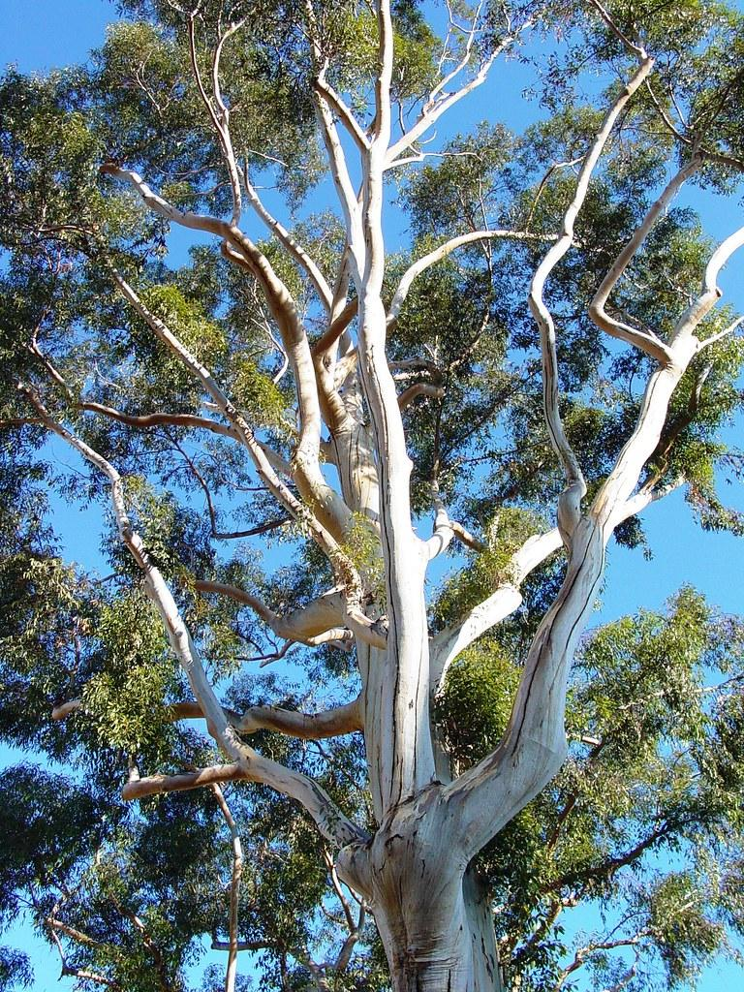
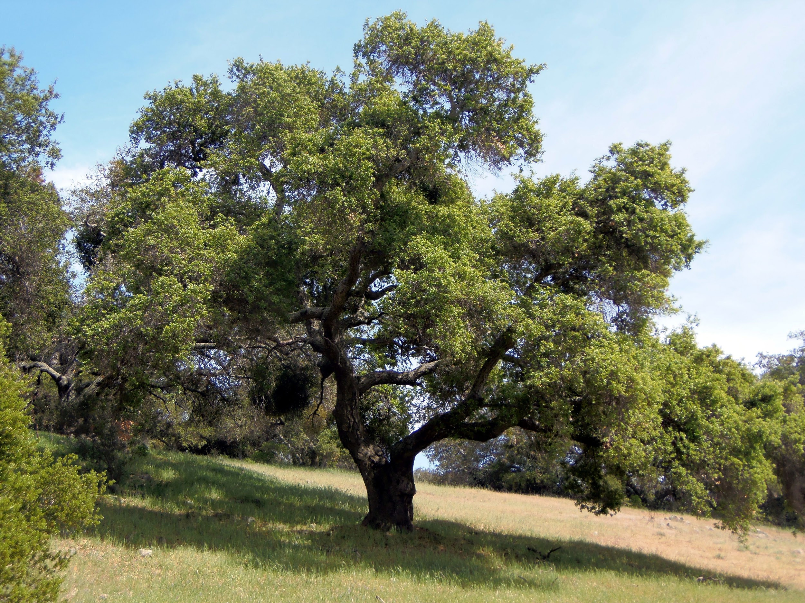
Each Redlands Unified student will receive one of the following:
Stone Pine/
Pinus pinea
Full-sun tree growing to 40’ - 80’ high and 40’ wide over its 50-150 year lifespan; called the umbrella tree for its height relative to canopy shape
Chitalpa/ Chitalpa tashkentensis
25’ - 35’ max height over its 40 - 150 year lifespan; supports pollinators including hummingbirds
Eucalyptus/ Eucalyptus spp.
IE SoCal-friendly; over 900 unique species native to Australia, New Guinea, and Indonesia; dried leaves/tree oil used in a variety of medicines
Coast Live Oak/Quercus agrifolia
California native serving as a core food source for over 12 southern California Native American tribes! Coast live oaks reach up to 75’ high with root systems as deep as 40’ below ground.
Notes:
Show pictures and ask students to guess trees

Slide 11
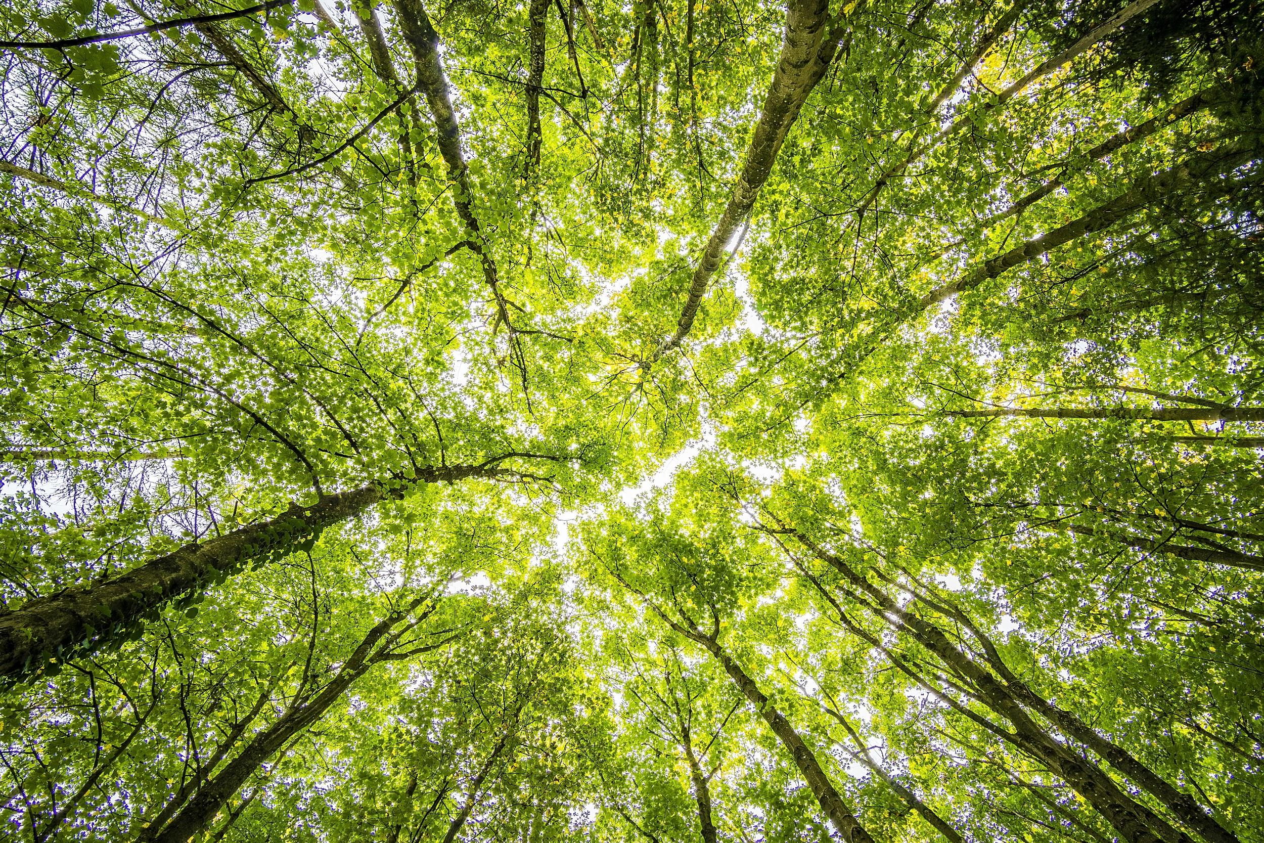
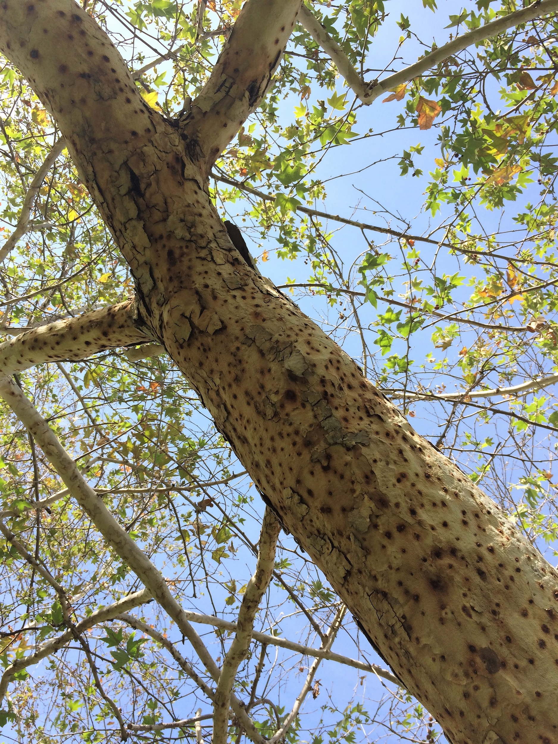
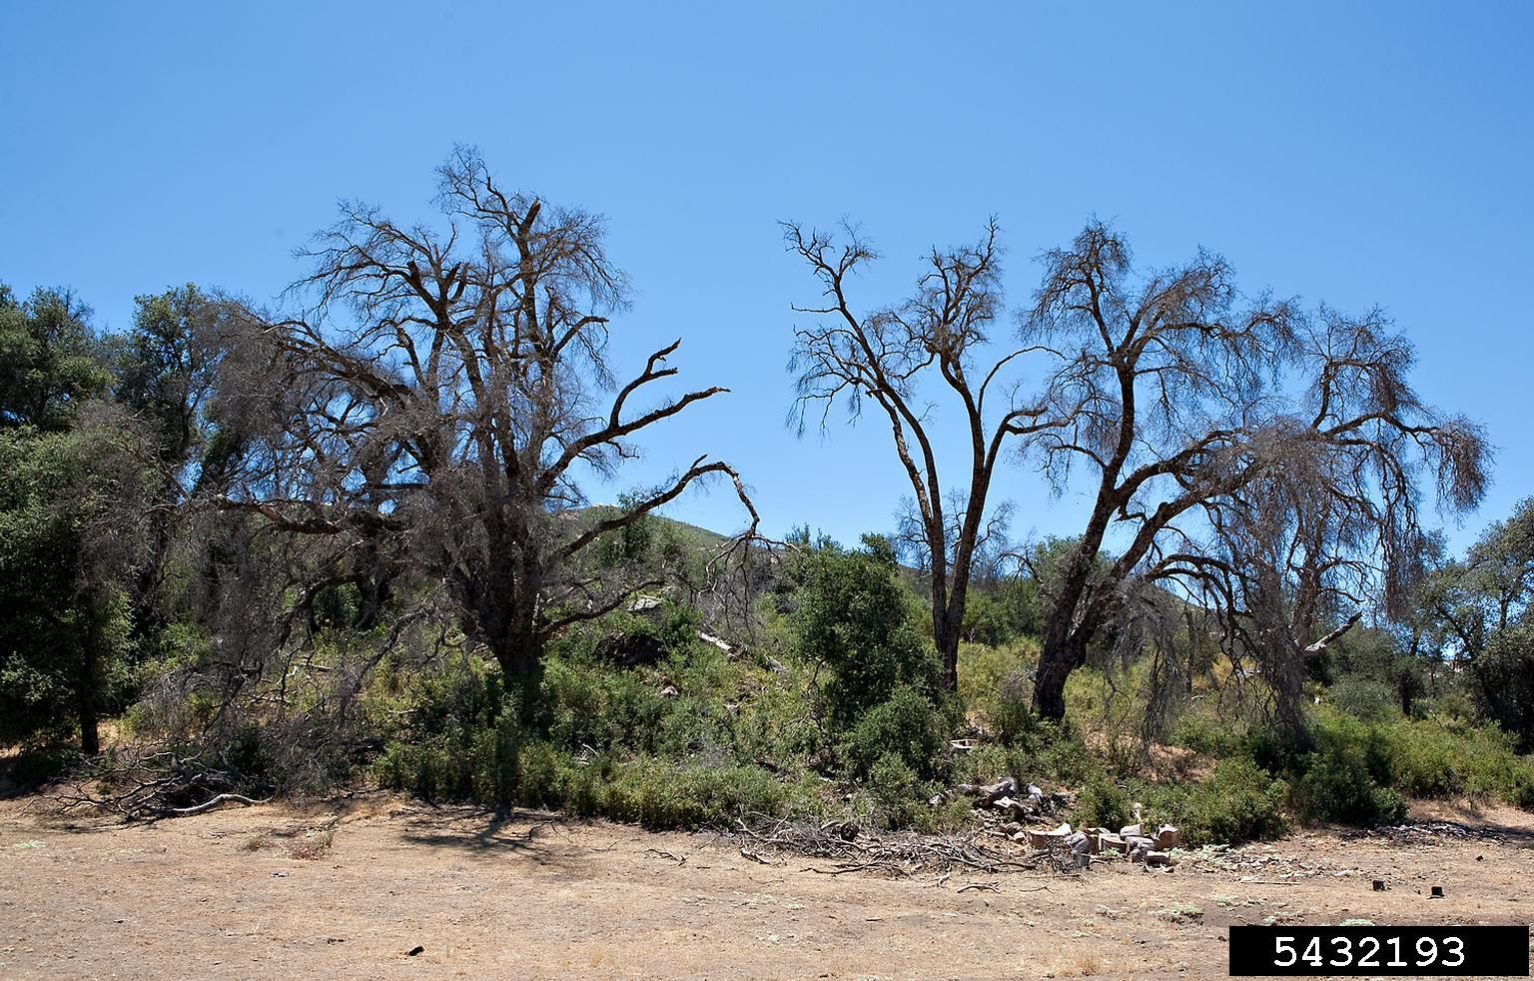
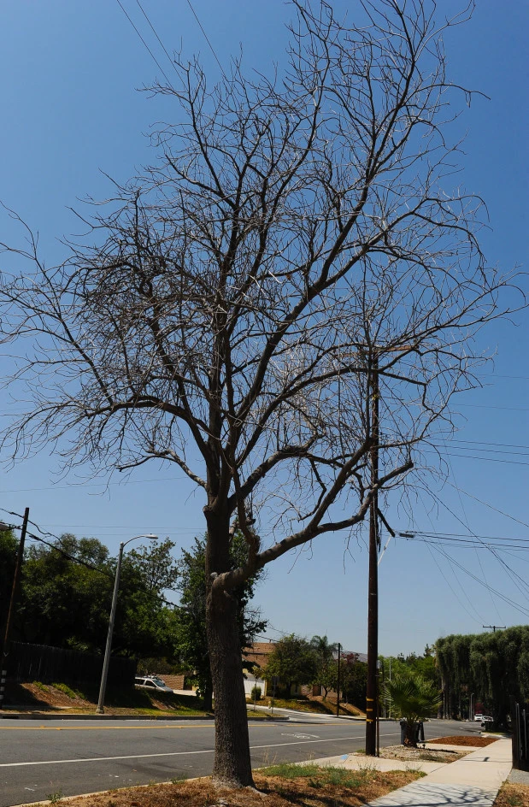
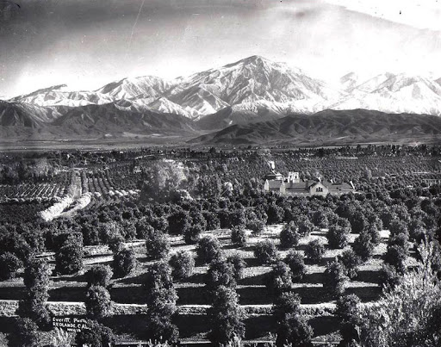
Do we really need more trees?
Tree death from invasive pests: Gold Spotted Oak Borer (GSOB) and Invasive Shot Hole Borer (ISHB)
Drought stress
Development-related tree loss
HS-LS4-6. LS4.C: Changes in the physical environment, whether naturally occurring or human induced, have thus contributed to the expansion of some species, the emergence of new distinct species as populations diverge under different conditions, and the decline–and sometimes the extinction–of some species.
Notes:
Why do we need to plant trees locally? One major reason is human-induced tree loss:
Development - large-scale loss of fruit trees to make room for higher-dollar residential development. Does Redlands still resemble the picture shown in this presentation? Why or why not?
Pests spread via human sale and movement of firewood - Gold Spotted Oak Borer (GSOB) and Invasive Shot Hole Borer (ISHB). GSOB is moving north, most recently confirmed in multiple locations in the San Bernardino mountains and killing multiple species of native oak trees. ISHB is also moving north and attacks over 41 species of native, landscaping, and citrus trees throughout southern California. Collectively, these pests are killing trees and not enough is known to stop them
Stress/damage from long-term drought and from cutting back dramatically on residential water use in response to the drought; some street trees and yard trees have not recovered and have been removed and/or will be removed
Each tree added improves local air quality, captures water runoff, provides habitat for species, and benefits quality of life for humans. Ask students to list other benefits of trees and keep a list at the front of the room.

Slide 12
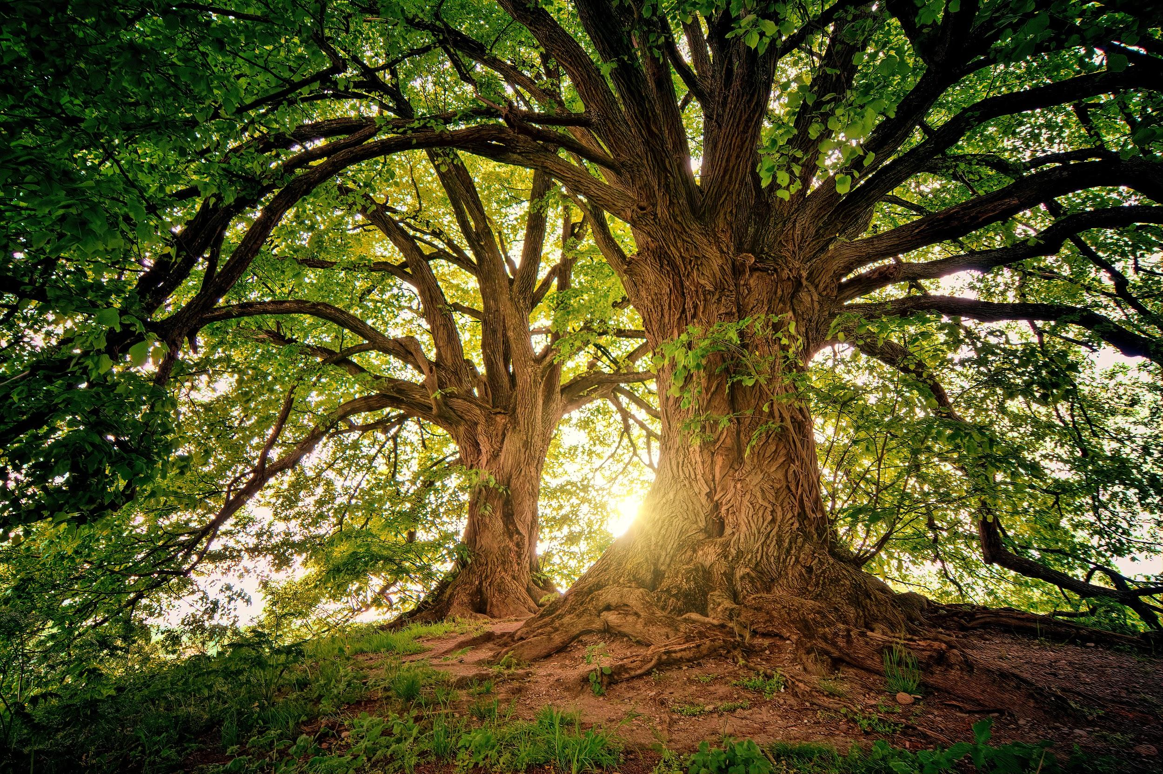
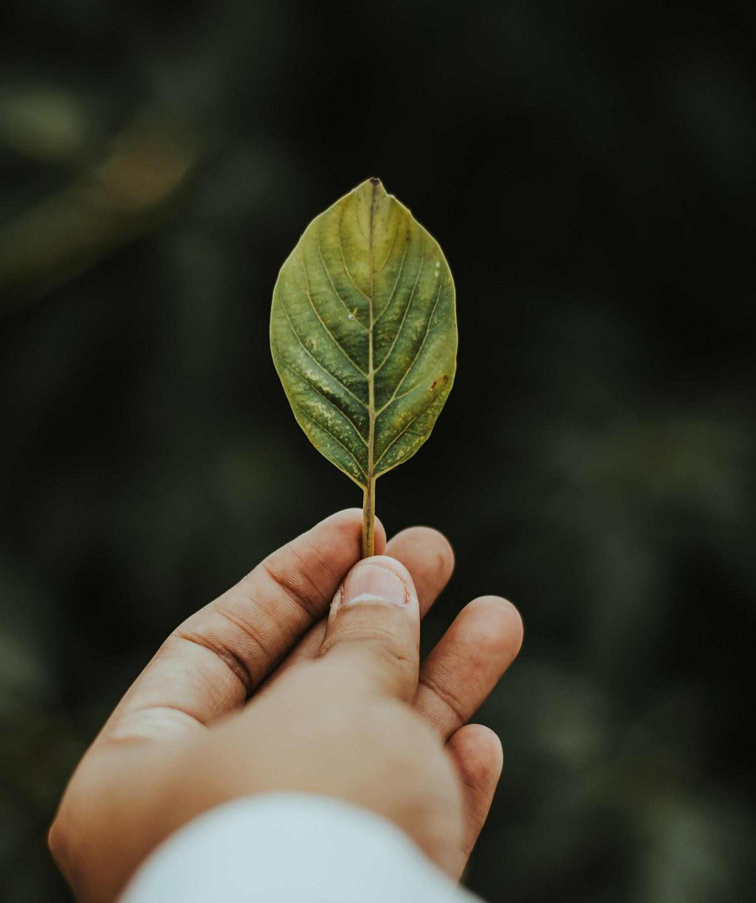
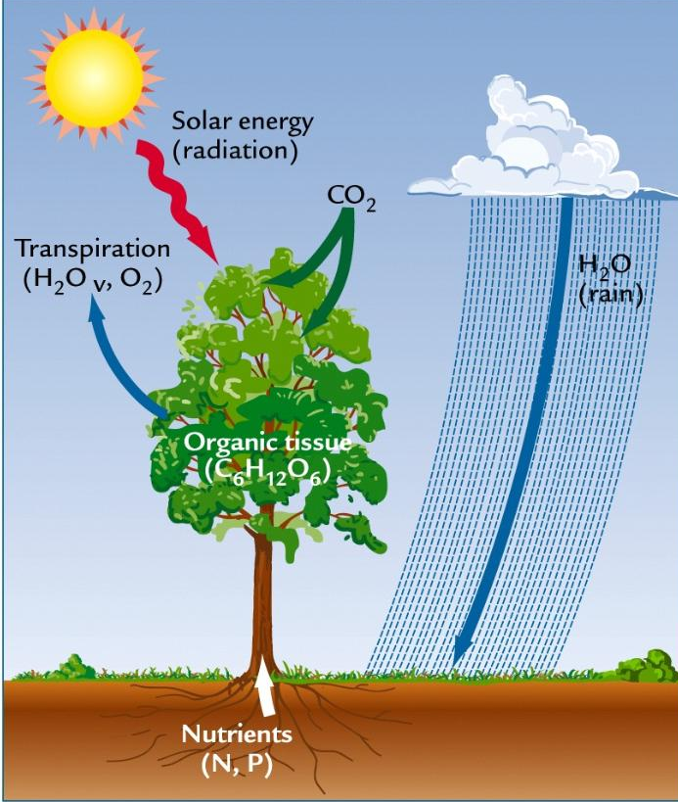
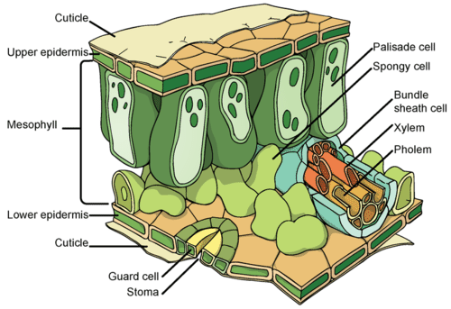
Planting Trees: How do they grow?
Plants, algae, and bacteria are the only organisms that can harvest sunlight and use the energy to convert CO2 (carbon dioxide) to organic material. During the process of photosynthesis, plants produce oxygen, which constitutes a significant portion of the air that we breathe so less plants means less recycling of carbon dioxide and less oxygen production.
This process results in tree growth, improved air quality, absorption and retention of atmospheric carbon, one of the central drivers of climate change
The water in leaves converts light energy into glucose via the photosynthesis process, absorbing CO2 and sending O2 and H2O back into the atmosphere.
Notes:
Tree function - photosynthesis:
Conversion of light energy, water, and CO2 into glucose and O2 for ongoing tree growth/development
Specific role of leaves in photosynthesis - water moisture, sunlight capture, CO2 uptake through stomata resulting in transport of glucose into other sections of the tree
Benefits in addition to tree growth:
CO2 reduction in atmosphere
Carbon sink via long-term storage in segments of tree
Air quality improvement, healthier trees live longer and extend multiplying benefits of that larger, hardier tree which in turn benefits humans

Slide 13
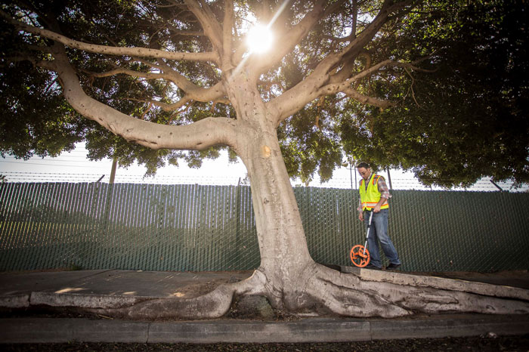
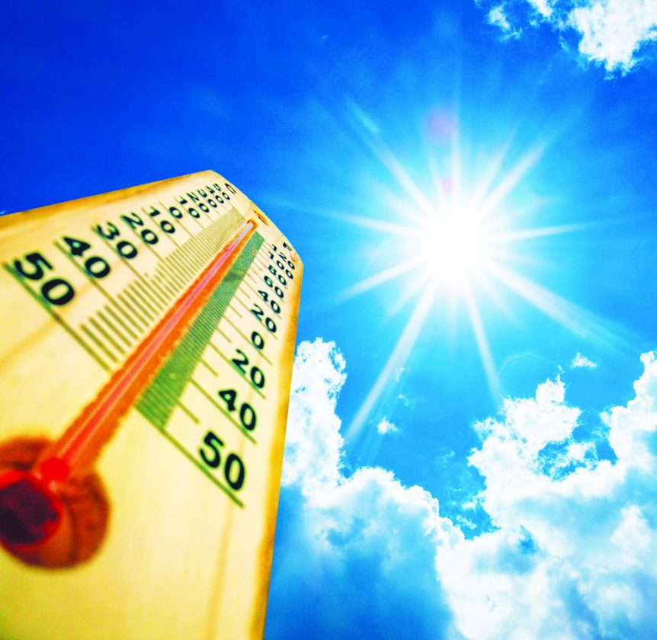
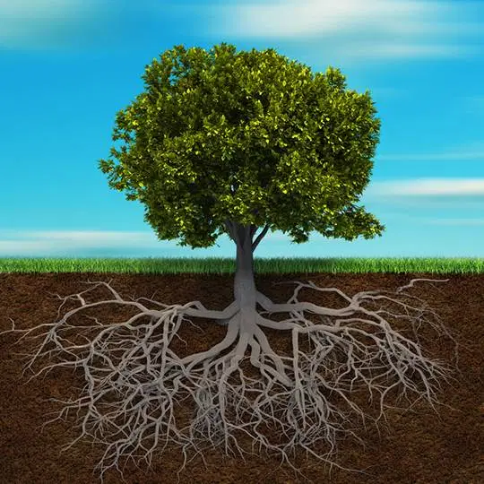

Planting Trees: Know Before You Plant!
Tree height/width anticipated when full-grown: make sure there is adequate space in the planting spot
Avoid transplanting during extreme heat
More on trees at redlands.edu/trees
Soil and light needs: is it being planted in the best location for drainage and sun?
Notes:
Promotion of redlands.edu/trees website: research BEFORE planting is key to long-term success of trees

Slide 14
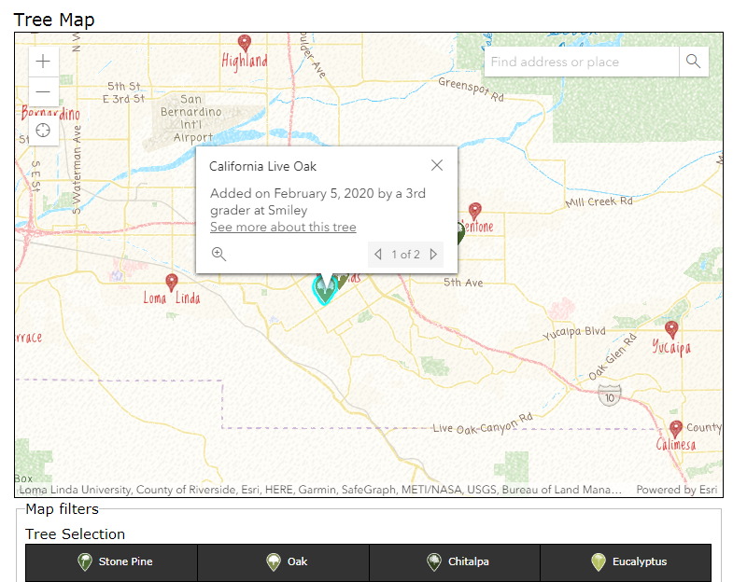
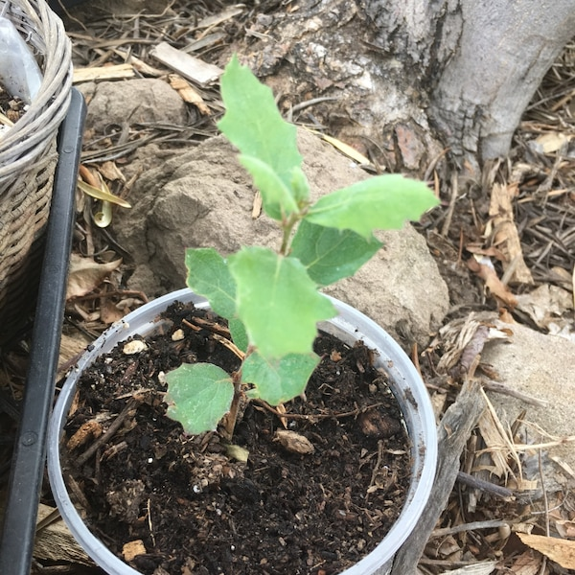
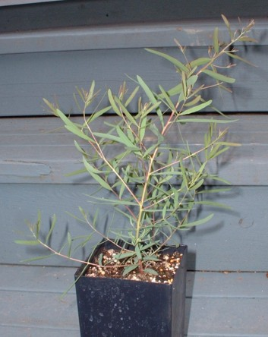
Planting Trees: Mapping your Tree
Map your tree by species and general location using the Plant-A-Thon Map
redlands.edu/trees
Notes:
Using the website to begin community mapping of trees given away - map of general location and tree type as shown in samples on redlands.edu/trees

Slide 15
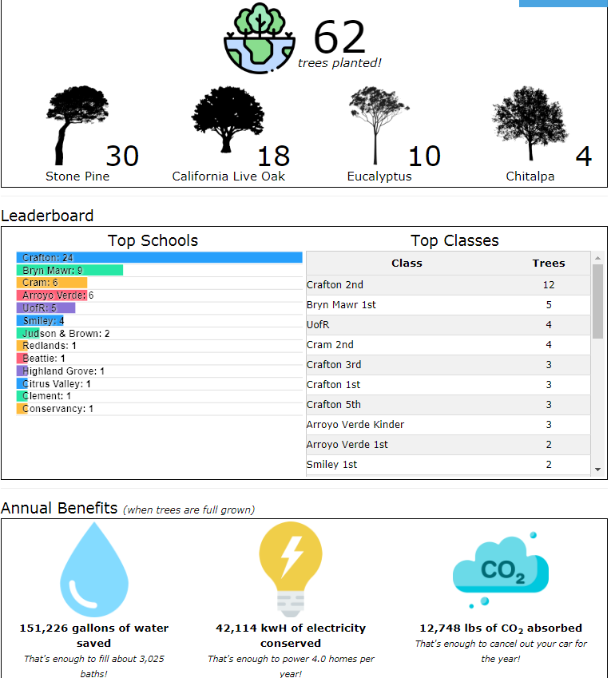
Planting Trees: Tracking your Tree’s Benefits
Once mapped, your tree will demonstrate benefits based on species type
Check back at redlands.edu/trees for updates on benefits by school and neighborhood!
Notes:
Once mapped, tree data will begin accumulation of benefits data, allowing students and families to view elevating benefits by region/school

Slide 16
Break into four groups for…
The Value of a Tree
Stone Pine/
Pinus pinea
Chitalpa/ Chitalpa tashkentensis
Coast Live Oak/Quercus agrifolia
Eucalyptus/ Eucalyptus spp.
Notes:
Brain Break for activity - The Value of a Tree
Design a value tag to help people understand the dollar value and many benefits of an individual tree.
Teacher will break the class into four groups corresponding to the four species that students may receive.
Each group will research and be responsible for creating one tree tag.Go to website below to get value facts about your tree.
http://www.treebenefits.com/calculator/treeinfor.cfm?zip=61821&city=CHAMPAIGN&state=IL&climatezone=Midwest&country=US

Slide 17

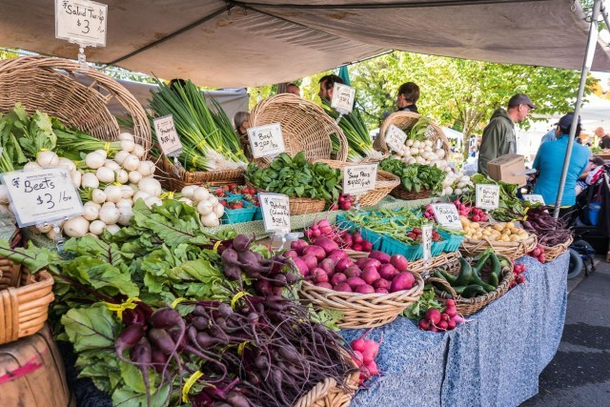
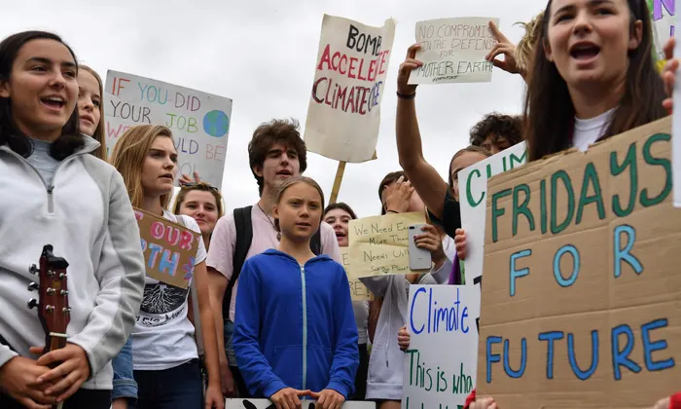
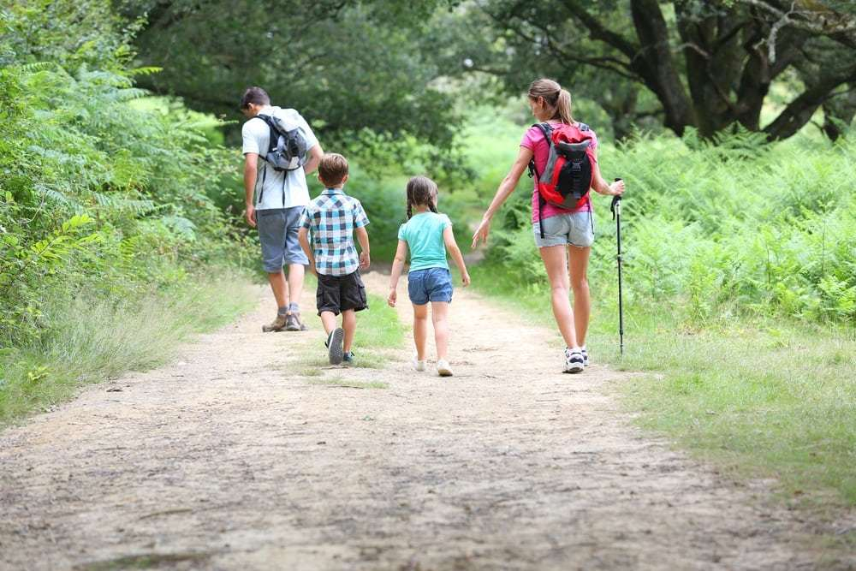
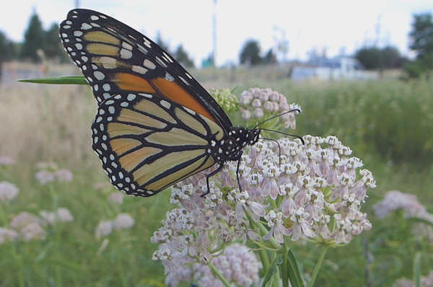
How else will you celebrate Earth Day?
Notes:
Other ideas for Earth Day:
Student ideas first; then:
Reduce waste by donating clothes you no longer need
Find a local peaceful conservation demonstration you can participate in
Get outside!
Plant pollinator habitat
Eat locally - farmer’s markets and local places of business that support local ag

Slide 18
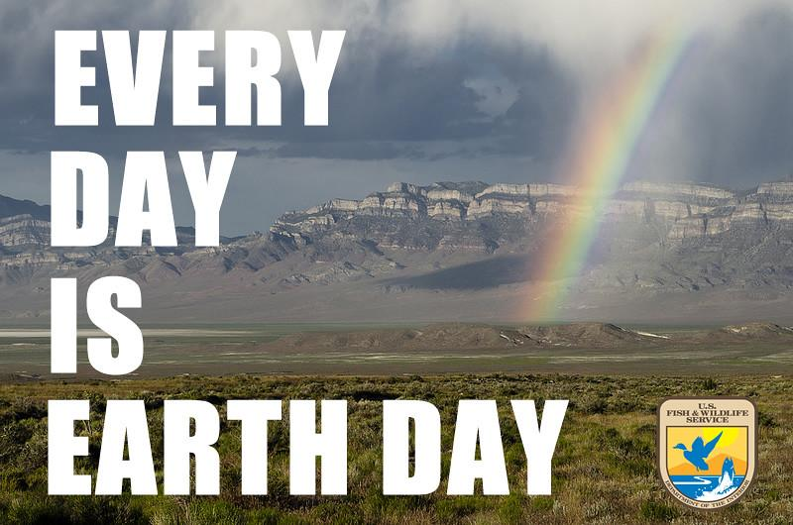
redlands.edu/trees
Notes:
Thank you to students
Additional redlands.edu/trees demo at end, time permitting: map, resources, activities

